Slide 1

What is Statistical Learning?
Chapter 02 – Part I

Slide 2
Outline
What Is Statistical Learning?
Why estimate f?
How do we estimate f?
The trade-off between prediction accuracy and model interpretability
Supervised vs. unsupervised learning
Regression vs. classification problems

Slide 3
What is Statistical Learning?
Suppose we observe Y_{i} and X_{i} =(X_{i1} , X_{i2},…, X_{ip}) for i = 1, …, n
We believe that there is a relationship between Y and at least one of the X’s.
We can model the relationship as
Where f is an unknown function and ε is a random error with mean zero.
Notes:
More generally, suppose that we observe a quantitative response Y and p different predictors, X1, X2,...,Xp.
We assume that there is some relationship between Y and X = (X1, X2,...,Xp), which can be written in the very general form
Y = f(X) + e
Here f is some fixed but unknown function of X1,...,Xp, and is a random error term, which is independent of X and has mean zero. In this formulation, f represents the systematic information that X provides about Y .

Slide 4
A Simple Example
Notes:
The green dots are the observed values of Y and X of for about 100 observations individuals.

Slide 5
A Simple Example
ε_{i}
f
Notes:
The red curve represents the modeled relationship between Y and X,. The black lines represent the error associated with a highlighted observation. Note, if I were to draw these lines between every point, some errors are positive (if an observation lies above the red curve) and some are negative (if an observation lies below the curve). Overall, these errors have approximately mean zero.

Slide 6
Different Standard Deviations
The difficulty of estimating f will depend on the standard deviation of the ε’s.

Slide 7
Different Estimates For f

Slide 8
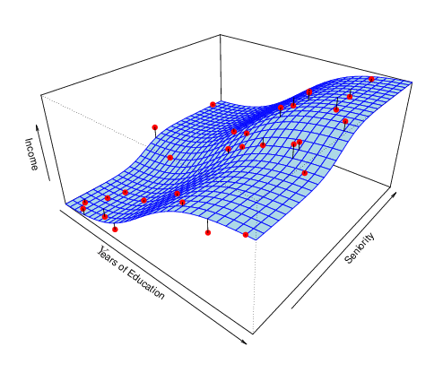
Income vs. Education Seniority
Notes:
In general, the function f may involve more than one input variable. In figure, we plot income as a function of years of education and seniority. Here f is a surface that must be estimated based on the observed data.
The plot displays income as a function of years of education and seniority in the Income data set. The blue surface represents the true underlying relationship between income and years of education and seniority, which is known since the data are simulated. The red dots indicate the observed values of these quantities for 30 individuals.

Slide 9
Why Do We Estimate f?
Statistical Learning, and this course, are all about how to estimate f.
The term statistical learning refers to using the data to “learn” f.
Why do we care about estimating f ?
There are 2 reasons for estimating f,
Prediction and
Inference.
Notes:
statistical learning refers to a set of approaches for estimating f. In this lecture we outline some of the key theoretical concepts that arise in estimating f, as well as tools for evaluating the estimates obtained.
There are two main reasons that we may wish to estimate f: prediction and inference. We discuss each in turn.

Slide 10
1. Prediction
If we can produce a good estimate for f (and the variance of ε is not too large) we can make accurate predictions for the response, Y, based on a new value of X.
Notes:
In many situations, a set of inputs X are readily available, but the output Y cannot be easily obtained. In this setting, since the error term averages to zero, we can predict Y using our estimate for f.

Slide 11
Example: Direct Mailing Prediction
Interested in predicting how much money an individual will donate based on observations from 90,000 people on which we have recorded over 400 different characteristics.
Don’t care too much about each individual characteristic.
Just want to know: For a given individual should I send out a mailing?
Notes:
For instance, consider a company that is interested in conducting a direct-marketing campaign. The goal is to identify individuals who will respond positively to a mailing, based on observations of demographic variables measured on each individual. In this case, the demographic variables serve as predictors, and response to the marketing campaign (either positive or negative) serves as the outcome. The company is not interested in obtaining a deep understanding of the relationships between each individual predictor and the response; instead, the company simply wants an accurate model to predict the response using the predictors.
In this setting, ˆf is often treated as a black box, in the sense that one is not typically concerned with the exact form of ˆf, provided that it yields accurate predictions for Y .

Slide 12
2. Inference
Alternatively, we may also be interested in the type of relationship between Y and the X's.
For example,
Which particular predictors actually affect the response?
Is the relationship positive or negative?
Is the relationship a simple linear one or is it more complicated etc.?
Notes:
We are often interested in understanding the way that Y is affected as X1,...,Xp change. In this situation we wish to estimate f, but our goal is not necessarily to make predictions for Y . We instead want to understand the relationship between X and Y , or more specifically, to understand how Y changes as a function of X1,...,Xp. Now ˆf cannot be treated as a black box, because we need to know its exact form.

Slide 13
Example: Housing Inference
Wish to predict median house price based on 14 variables.
Probably want to understand which factors have the biggest effect on the response and how big the effect is.
For example how much impact does a river view have on the house value etc.
Notes:
Finally, some modeling could be conducted both for prediction and inference. For example, in a real estate setting, one may seek to relate values of homes to inputs such as crime rate, zoning, distance from a river, air quality, schools, income level of community, size of houses, and so forth. In this case one might be interested in how the individual input variables affect the prices—that is, how much extra will a house be worth if it has a view of the river? This is an inference problem.
You could also apply this data in a purely predictive sense. You may simply be interested in predicting the value of a home given its characteristics: is this house under- or over-valued? This is a prediction problem.

Slide 14
How Do We Estimate f?
We will assume we have observed a set of training data
We must then use the training data and a statistical method to estimate f.
Statistical Learning Methods:
Parametric Methods
Non-parametric Methods
Notes:
Throughout this book, we explore many linear and non-linear approaches for estimating f. However, these methods generally share certain characteristics. We will always assume that we have observed a set of n different data points. These observations are called the training data because we will use these training data observations to train, or teach, our method how to estimate f.
Our goal is to apply a statistical learning method to the training data in order to estimate the unknown function f. In other words, we want to find a function ˆf such that Y ≈ ˆf(X) for any observation (X, Y ). Broadly speaking, most statistical learning methods for this task can be characterized as either parametric or non-parametric.

Slide 15
Parametric Methods
It reduces the problem of estimating f down to one of estimating a set of parameters.
They involve a two-step model based approach
STEP 1:
Make some assumption about the functional form of f, i.e. come up with a model. The most common example is a linear model i.e.
However, in this course we will examine far more complicated, and flexible, models for f. In a sense the more flexible the model the more realistic it is.
Notes:
The model-based approach just described is referred to as parametric; it reduces the problem of estimating f down to one of estimating a set of parameters
Parametric methods involve a two-step model-based approach.
First, we make an assumption about the functional form, or shape, of f. For example, one very simple assumption is that f is linear in X:
This is a linear model, which will be discussed extensively in Chapter 3. Once we have assumed that f is linear, the problem of estimating f is greatly simplified. Instead of having to estimate an entirely arbitrary p-dimensional function f(X), one only needs to estimate the p + 1 coefficients β0, β1,...,βp.

Slide 16
Parametric Methods (cont.)
STEP 2:
Use the training data to fit the model i.e. estimate f or equivalently the unknown parameters such as β₀, β₁, β₂,…, β_{p}.
The most common approach for estimating the parameters in a linear model is ordinary least squares (OLS).
However, this is only one way.
We will see in the course that there are often superior approaches.
Notes:
After a model has been selected, we need a procedure that uses the training data to fit or train the model. In the case of the linear model fit train, we need to estimate the parameters β0, β1,...,βp. That is, we want to find values of these parameters such that Y ≈ β0 + β1X1 + β2X2 + ... + βpXp. The most common approach to fitting the model is referred to as (ordinary) least squares, which we discuss in Chapter 3. However, least squares least squares is one of many possible ways to fit the linear model. In Chapter 6, we discuss other approaches for estimating the parameters β0, β1,...,βp.

Slide 17
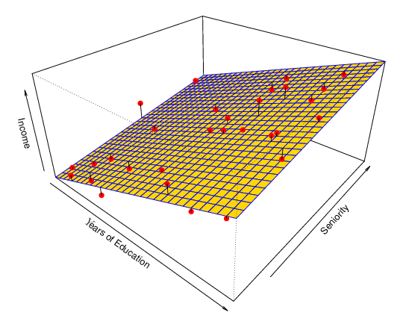
Example: A Linear Regression Estimate
Even if the standard deviation is low we will still get a bad answer if we use the wrong model.
Notes:
Figure 2.4 shows an example of the parametric approach applied to the Income data from Figure 2.3. We have fit a linear model of the form
income ≈ β0 + β1 × education + β2 × seniority.
Since we have assumed a linear relationship between the response and the two predictors, the entire fitting problem reduces to estimating β0, β1, and β2, which we do using least squares linear regression. Comparing Figure blue to Figure yellow, we can see that the linear fit given in Figure yellow is not quite right: the true f has some curvature that is not captured in the linear fit. However, the linear fit still appears to do a reasonable job of capturing the positive relationship between years of education and income, as well as the slightly less positive relationship between seniority and income. It may be that with such a small number of observations, this is the best we can do.

Slide 18
Non-parametric Methods
They do not make explicit assumptions about the functional form of f.
Advantages: They accurately fit a wider range of possible shapes of f.
Disadvantages: A very large number of observations is required to obtain an accurate estimate of f
Notes:
Non-parametric methods do not make explicit assumptions about the functional form of f. Instead they seek an estimate of f that gets as close to the data points as possible without being too rough or wiggly. Such approaches can have a major advantage over parametric approaches: by avoiding the assumption of a particular functional form for f, they have the potential to accurately fit a wider range of possible shapes for f. Any parametric approach brings with it the possibility that the functional form used to estimate f is very different from the true f, in which case the resulting model will not fit the data well. In contrast, non-parametric approaches completely avoid this danger, since essentially no assumption about the form of f is made. But non-parametric approaches do suffer from a major disadvantage: since they do not reduce the problem of estimating f to a small number of parameters, a very large number of observations (far more than is typically needed for a parametric approach) is required in order to obtain an accurate estimate for f.

Slide 19
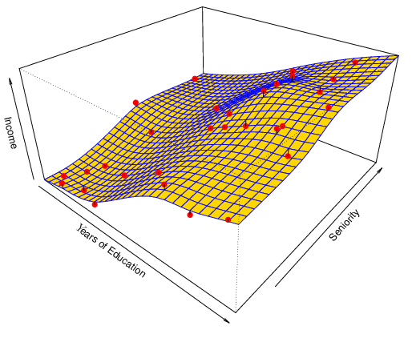
Example: A Thin-Plate Spline Estimate
Non-linear regression methods are more flexible and can potentially provide more accurate estimates.
Notes:
An example of a non-parametric approach to fitting the Income data is shown in Figure yellow. A thin-plate spline is used to estimate f. This approach does not impose any pre-specified model on f. It instead attempts to produce an estimate for f that is as close as possible to the observed data, subject to the fit—that is, the yellow surface in Figure —being smooth.
In this case, the non-parametric fit has produced a remarkably accurate estimate of the true f shown in Figure blue

Slide 20
Tradeoff Between Prediction Accuracy and Model Interpretability
Why not just use a more flexible method if it is more realistic?
There are two reasons:
Reason 1: A simple method such as linear regression produces a model which is much easier to interpret (the Inference part is better). For example, in a linear model, β_{j} is the average increase in Y for a one unit increase in X_{j} holding all other variables constant.
Reason 2: Even if you are only interested in prediction, so the first reason is not relevant, it is often possible to get more accurate predictions with a simple, instead of a complicated, model. This seems counter intuitive but has to do with the fact that it is harder to fit a more flexible model.
Notes:
One might reasonably ask the following question: why would we ever choose to use a more restrictive method instead of a very flexible approach? There are several reasons that we might prefer a more restrictive model. If we are mainly interested in inference, then restrictive models are much more interpretable. For instance, when inference is the goal, the linear model may be a good choice since it will be quite easy to understand the relationship between Y and X1, X2,...,Xp. In contrast, very flexible approaches, such as the splines discussed in Chapter 7 and displayed in , and the boosting methods discussed in Chapter 8, can lead to such complicated estimates of f that it is difficult to understand how any individual predictor is associated with the response.
The potential disadvantage of a parametric approach is that the model we choose will usually not match the true unknown form of f. If the chosen model is too far from the true f, then our estimate will be poor. We can try to address this problem by choosing flexible models that can fit many different possible functional forms flexible for f. But in general, fitting a more flexible model requires estimating a greater number of parameters. These more complex models can lead to a phenomenon known as overfitting the data, which essentially means they overfitting follow the errors, or noise, too closely.

Slide 21
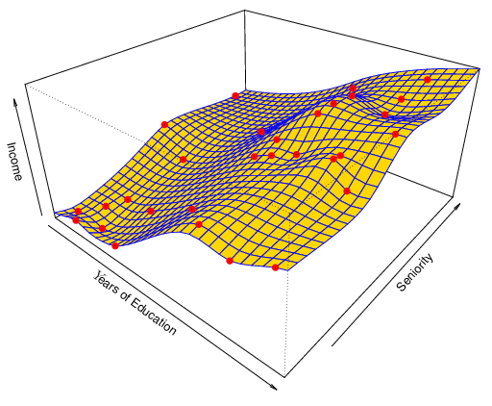
A Poor Estimate
Non-linear regression methods can also be too flexible and produce poor estimates for f.
Notes:
In order to fit a thin-plate spline, the data analyst must select a level of smoothness. Figure yellow shows the same thin-plate spline fit using a lower level of smoothness, allowing for a rougher fit. The resulting estimate fits the observed data perfectly! However, the spline fit shown in Figure yellow is far more variable than the true function f, from Figure blue. This is an example of overfitting the data, which we discussed previously. It is an undesirable situation because the fit obtained will not yield accurate estimates of the response on new observations that were not part of the original training data set. We discuss methods for choosing the correct amount of smoothness in Chapter 5. Splines are discussed in Chapter 7.
We have established that when inference is the goal, there are clear advantages to using simple and relatively inflexible statistical learning methods. In some settings, however, we are only interested in prediction, and the interpretability of the predictive model is simply not of interest. For instance, if we seek to develop an algorithm to predict the price of a stock, our sole requirement for the algorithm is that it predict accurately— interpretability is not a concern. In this setting, we might expect that it will be best to use the most flexible model available. Surprisingly, this is not always the case! We will often obtain more accurate predictions using a less flexible method. This phenomenon, which may seem counterintuitive at first glance, has to do with the potential for overfitting in highly flexible methods.

Slide 22
Supervised vs. Unsupervised Learning
We can divide all learning problems into Supervised and Unsupervised situations
Supervised Learning:
Supervised Learning is where both the predictors, X_{i}, and the response, Y_{i}, are observed.
This is the situation you deal with in Linear Regression classes (e.g. STA 4713).
Most of this course will also deal with supervised learning.
Notes:
Most statistical learning problems fall into one of two categories: supervised supervised or unsupervised. The examples that we have discussed so far in this chapter all fall into the supervised learning domain. For each observation of the predictor measurement(s) xi, i = 1,...,n there is an associated response measurement yi. We wish to fit a model that relates the response to the predictors, with the aim of accurately predicting the response for future observations (prediction) or better understanding the relationship between the response and the predictors (inference). Many classical statistical learning methods such as linear regression and logistic regression (Chapter 4), as logistic well as more modern approaches such as GAM, boosting, and support vec- regression tor machines, operate in the supervised learning domain. The vast majority of this book is devoted to this setting

Slide 23
Supervised vs. Unsupervised Learning
Unsupervised Learning:
In this situation only the X_{i}’s are observed.
We need to use the X_{i}’s to guess what Y would have been and build a model from there.
A common example is market segmentation where we try to divide potential customers into groups based on their characteristics.
A common approach is clustering.
We will consider unsupervised learning at the end of this course.
Notes:
In contrast, unsupervised learning describes the somewhat more challenging situation in which for every observation i = 1,...,n, we observe a vector of measurements xi but no associated response yi. It is not possible to fit a linear regression model, since there is no response variable to predict. In this setting, we are in some sense working blind; the situation is referred to as unsupervised because we lack a response variable that can supervise our analysis. What sort of statistical analysis is possible? We can seek to understand the relationships between the variables or between the observations. One statistical learning tool that we may use in this setting is cluster analysis, or clustering. The goal of cluster analysis cluster is to ascertain, on the basis of x1,...,xn, whether the observations fall into analysis relatively distinct groups. For example, in a market segmentation study we might observe multiple characteristics (variables) for potential customers, such as zip code, family income, and shopping habits. We might believe that the customers fall into different groups, such as big spenders versus low spenders. If the information about each customer’s spending patterns were available, then a supervised analysis would be possible. However, this information is not available—that is, we do not know whether each potential customer is a big spender or not. In this setting, we can try to cluster the customers on the basis of the variables measured, in order to identify distinct groups of potential customers. Identifying such groups can be of interest because it might be that the groups differ with respect to some property of interest, such as spending habits.

Slide 24
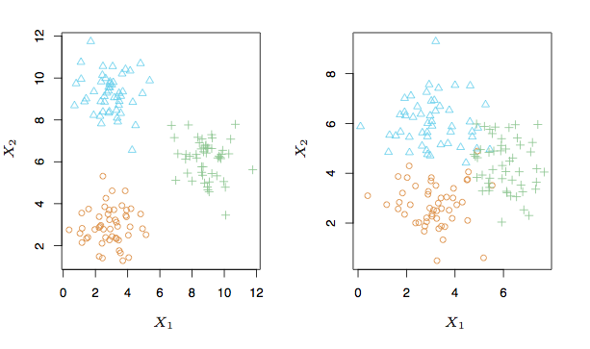
A Simple Clustering Example
Notes:
Figure 2.8 provides a simple illustration of the clustering problem. We have plotted 150 observations with measurements on two variables, X1 and X2. Each observation corresponds to one of three distinct groups. For illustrative purposes, we have plotted the members of each group using different colors and symbols. However, in practice the group memberships are unknown, and the goal is to determine the group to which each observation belongs. In the left-hand panel of Figure 2.8, this is a relatively easy task because the groups are well-separated. In contrast, the right-hand panel illustrates a more challenging problem in which there is some overlap between the groups. A clustering method could not be expected to assign all of the overlapping points to their correct group (blue, green, or orange).
In the examples shown in Figure 2.8, there are only two variables, and so one can simply visually inspect the scatterplots of the observations in order to identify clusters. However, in practice, we often encounter data sets that contain many more than two variables. In this case, we cannot easily plot the observations. For instance, if there are p variables in our data set, then p(p − 1)/2 distinct scatterplots can be made, and visual inspection is simply not a viable way to identify clusters. For this reason, automated clustering methods are important. We discuss clustering and other unsupervised learning approaches in Chapter 10.

Slide 25
Regression vs. Classification
Supervised learning problems can be further divided into regression and classification problems.
Regression covers situations where Y is continuous/numerical. e.g.
Predicting the value of the Dow in 6 months.
Predicting the value of a given house based on various inputs.
Classification covers situations where Y is categorical e.g.
Will the Dow be up (U) or down (D) in 6 months?
Is this email a SPAM or not?
Notes:
Variables can be characterized as either quantitative or qualitative (also known as categorical). Quantitative variables take on numerical values. Examples include a person’s age, height, or income, the value of a house, and the price of a stock. In contrast, qualitative variables take on values in one of K different classes, or categories. Examples of qualitative variables include a person’s gender (male or female), the brand of product purchased (brand A, B, or C), whether a person defaults on a debt (yes or no), or a cancer diagnosis (Acute Myelogenous Leukemia, Acute Lymphoblastic Leukemia, or No Leukemia). We tend to refer to problems with a quantitative response as regression problems, while those involving a qualitative response are often referred to as classification problems. However, the distinction is not always that crisp.

Slide 26
Different Approaches
We will deal with both types of problems in this course.
Some methods work well on both types of problem e.g. Neural Networks
Other methods work best on Regression, e.g. Linear Regression, or on Classification, e.g. k-Nearest Neighbors.
Notes:
Least squares linear regression (Chapter 3) is used with a quantitative response, whereas logistic regression (Chapter 4) is typically used with a qualitative (two-class, or binary) response. As such it is often used as a classification method. But since it estimates class probabilities, it can be thought of as a regression method as well. Some statistical methods, such as K-nearest neighbors (Chapters 2 and 4) and boosting (Chapter 8), can be used in the case of either quantitative or qualitative responses. We tend to select statistical learning methods on the basis of whether the response is quantitative or qualitative; i.e. we might use linear regression when quantitative and logistic regression when qualitative. However, whether the predictors are qualitative or quantitative is generally considered less important. Most of the statistical learning methods discussed in this book can be applied regardless of the predictor variable type, provided that any qualitative predictors are properly coded before the analysis is performed. This is discussed in Chapter 3.

